Slide 1
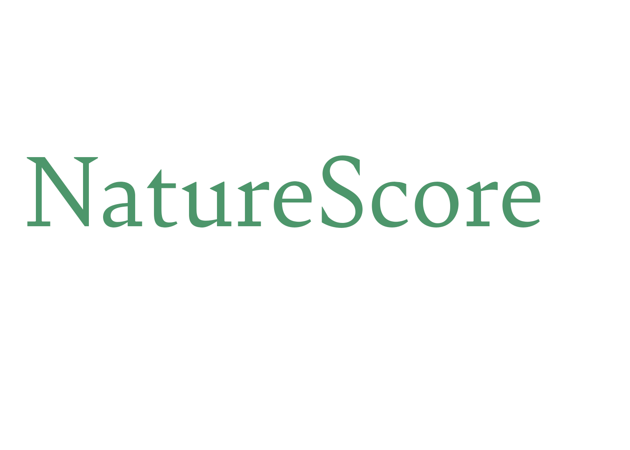
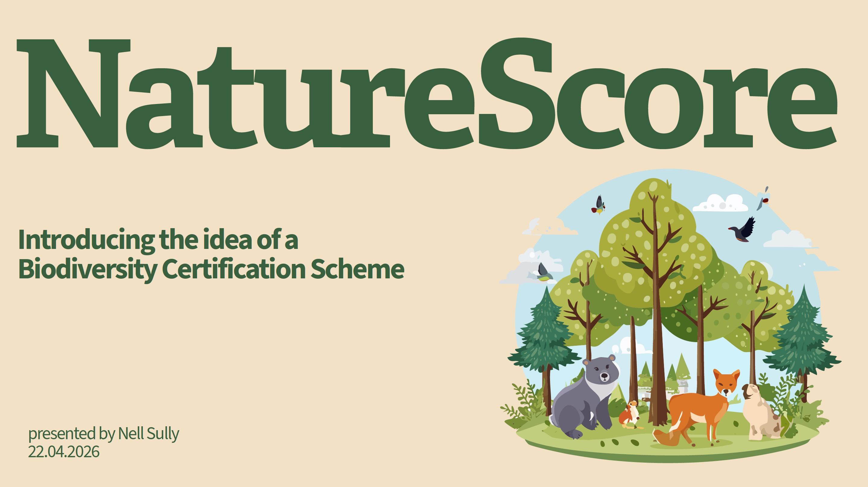

Slide 2
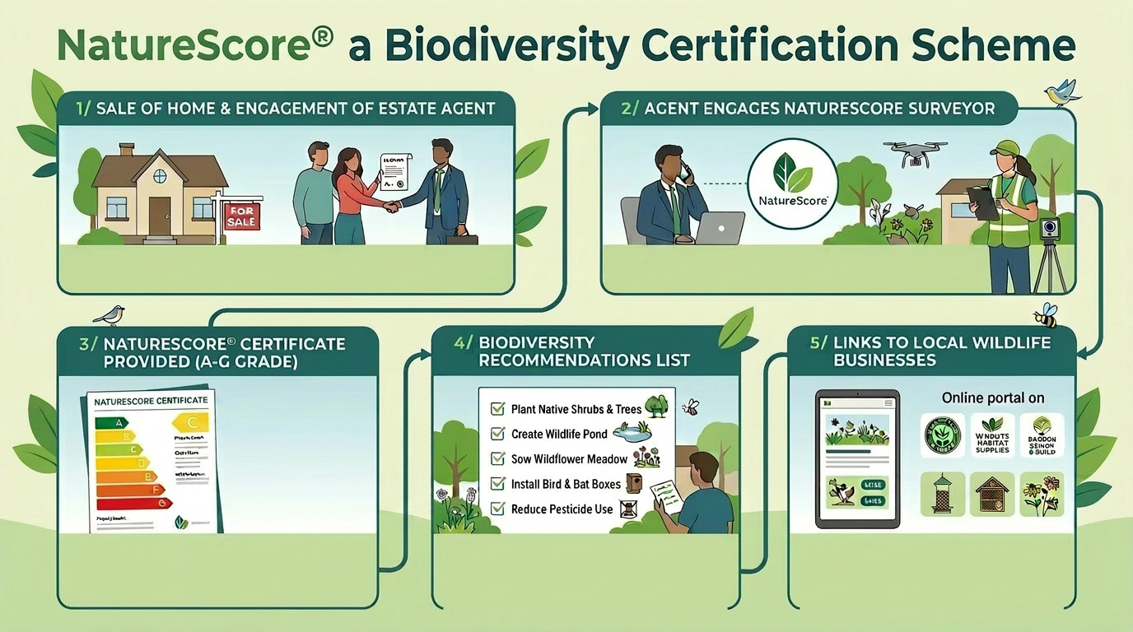

Slide 3
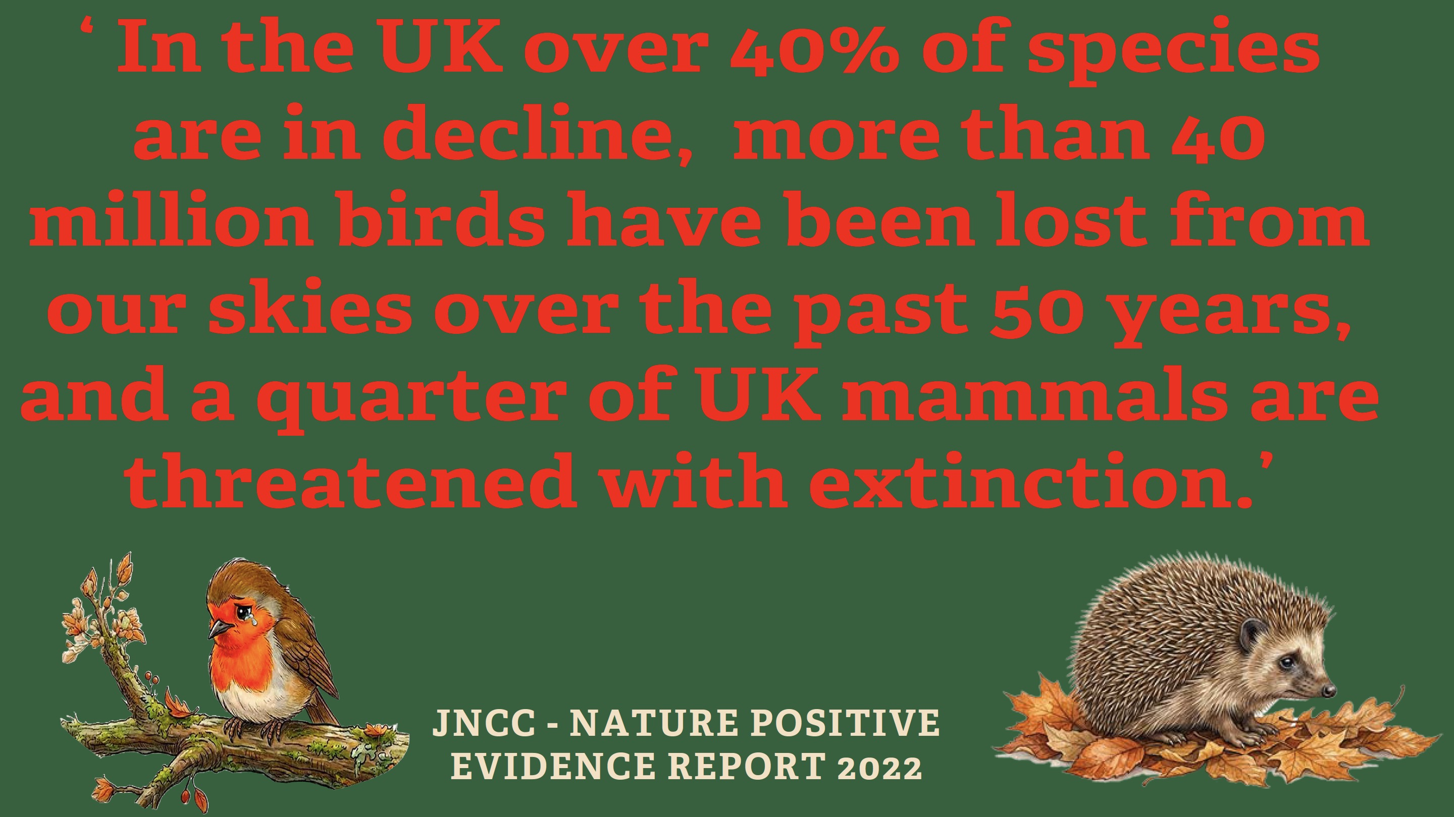
‘In the UK over 40% of species are in decline,
more than 40 million birds have been lost from our
skies over the past 50 years, and a quarter of
UK mammals are threatened with
extinction’

Slide 4
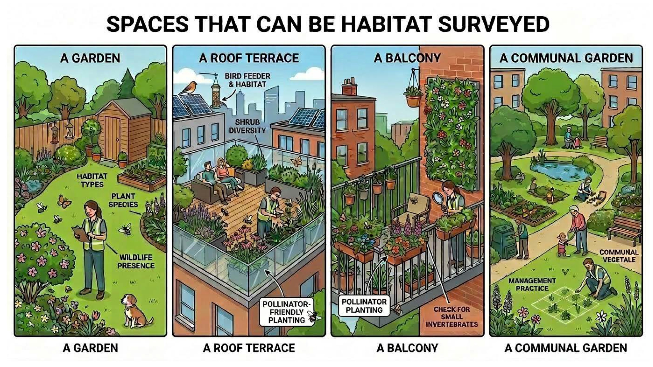

Slide 5
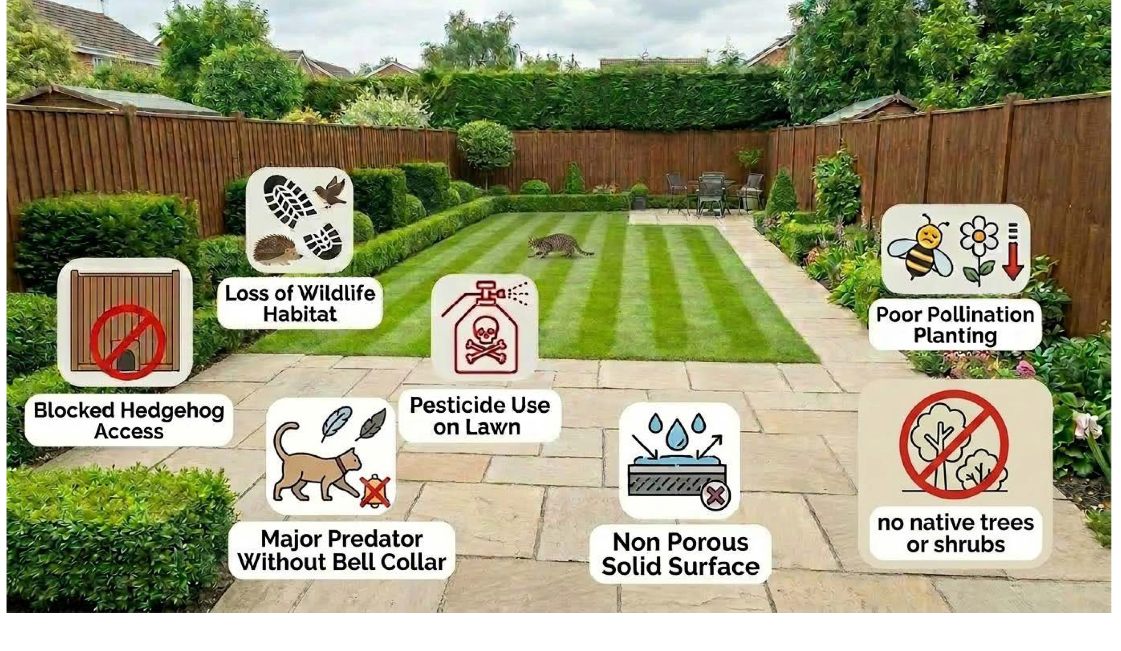

Slide 6
Private outdoor spaces are a significant but
underutilised resource for nature recovery
Residential gardens collectively cover a larger area than many protected landscapes

Slide 7
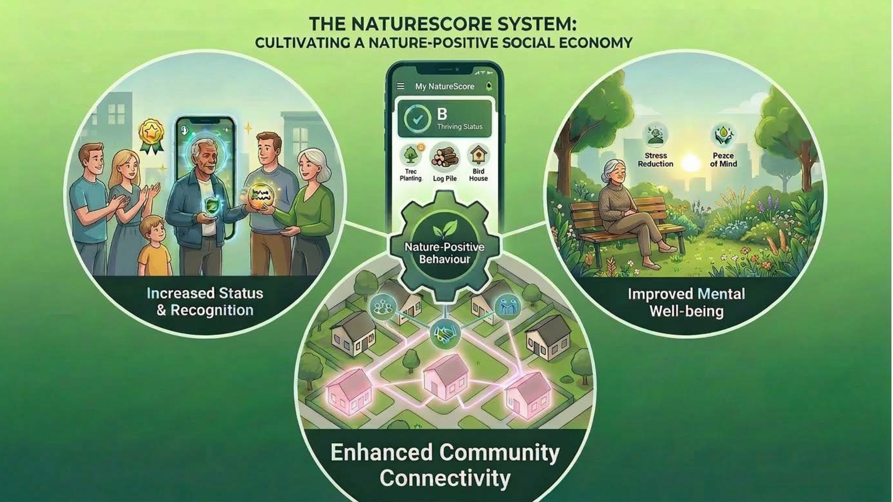

Slide 8
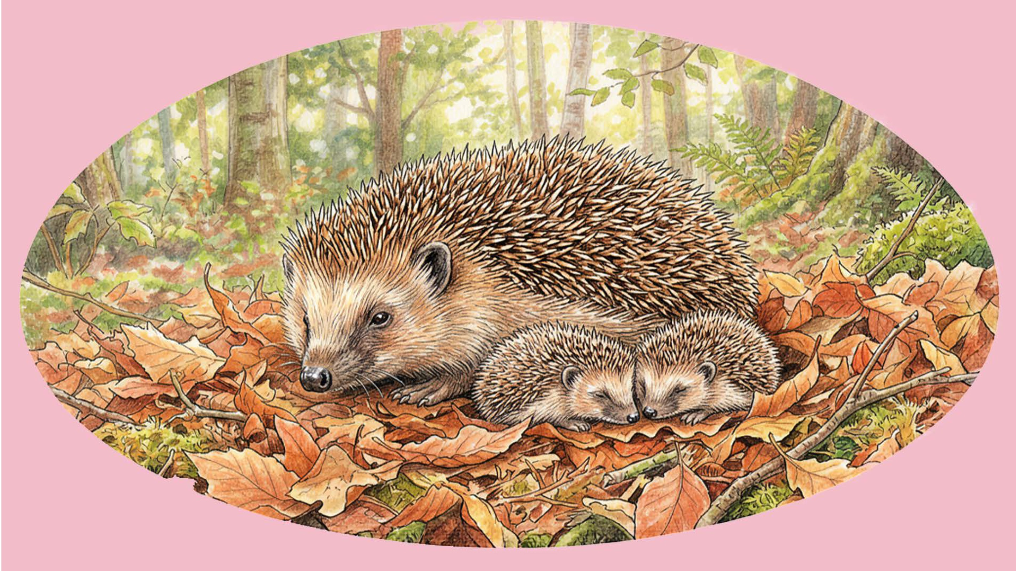

Slide 9
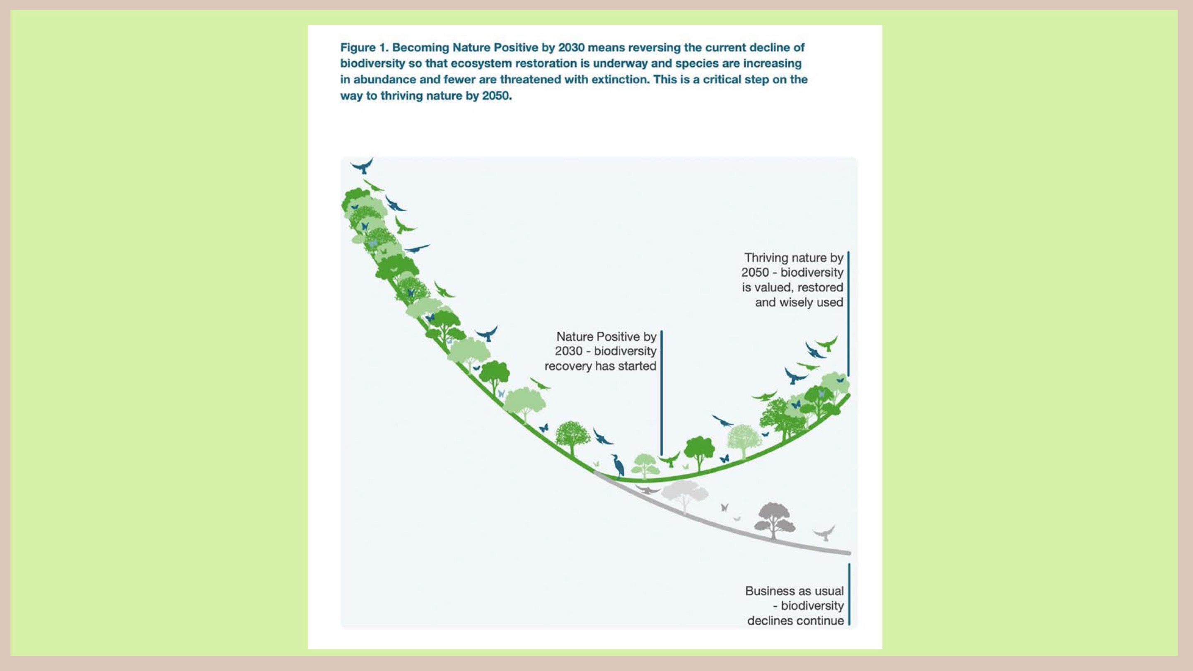

Slide 10
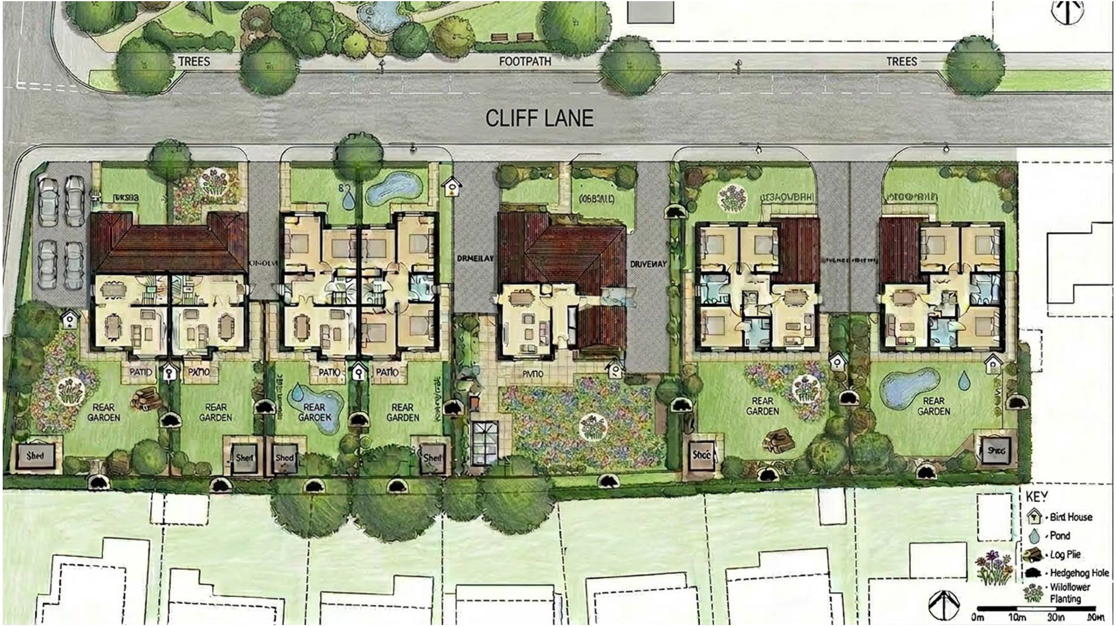

Slide 11
