Slide 1
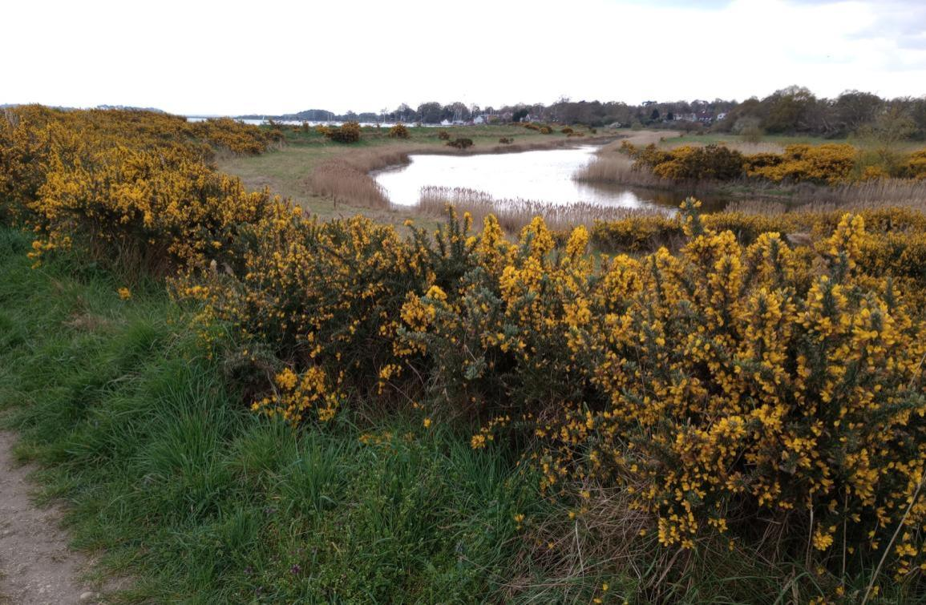
Parish Council Report for the
Waldringfield Annual Parish Meeting
April 2026

Slide 2
Members of the Parish Council:
Ian Kay | Chair/Parish Liaison/WALGA/Emergency Planning/Notice Board - Waldringfield Heath/Tennis Court
Janet Elliot | Vice Chair/Church Field Trust/Planning/SALC
Robert Forsdike | Playing Field
Serena Gold | Footpaths/Fairway Committee/Church Field Trust/Planning/Beach/Village Hall
Colin Reid | Fairway Committee/SID Coordinator/Felixstowe Partnership Liaison/Safeguarding Deputy
Sue Quick | Beach/Climate and Biodiversity Coordinator/Emergency Planning Liaison
Andrew Ratcliff
Jennifer Shone-Tribley | Clerk & RFO/Website/Safeguarding Lead/Notice Board – Cliff Rd
Jonathan Ramsey resigned from the Parish Council in January. Many thanks to Jonathan for his services. This leaves a vacancy for one councillor.
Any person interested in putting their name forward for this vacancy should contact the Parish Clerk for further details.
For more information go to: www.beacouncillor.org.uk
Parish Council Appointees:
Christine Fisher-Kay | Tree Warden
John Smith | Flood warden
Jon Wilkins | Deputy Flood Warden
Tony Lyon | Deputy Flood Warden/Defibrillator Liaison

Slide 3
Council Meetings
Council meetings are held on the 2nd Tuesday of the month at 7.30pm in the Village Hall. Dates for 2026/7 are:
  12th May 2025 (plus Annual Parish Council Meeting at 6.30pm)‏
  9th June 2025
  14th July 2025
  11th August 2025
  8th September 2025
  13th October 2025
  10th November 2025
  8th December 2025
  12th January 2026
  9th February 2026
  19^{h} March 2026
All Parish Council meetings are open to the public and there is an opportunity at these meetings for residents to put information to the Council and ask questions.
Agendas are posted on the two noticeboards and Waldringfielders three working day in advance of the meeting.

Slide 4
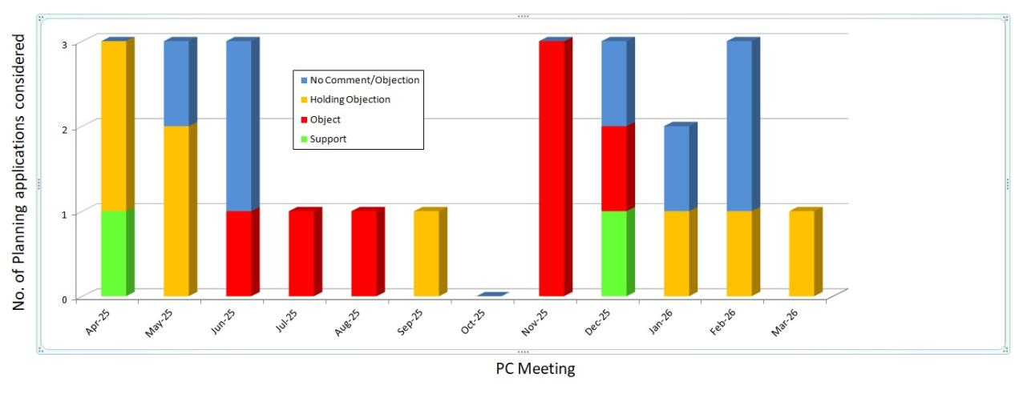
Council Activities
The Council has dealt with 24 planning applications since April 2025 (the average for the previous 10 years was 25.5):
2 were supported by the PC
7 were opposed by the PC (3 strongly)
for 8 the PC issued a ‘Holding Objection’ (pending further information)
for 7 the PC had ‘No Objection’ or ‘No comment’
Most of the work is done by the Planning Group, Janet Elliot, Serena Gold and (occasionally) Ian Kay, but decisions are taken by the full Council.

Slide 5
Council Activities
The Council provides funds for:
Parochial Church (grounds maintenance)
Church Field (grounds maintenance)
Waldringfield Wildlife Group (verges project)
Greener Waldringfield (website)
Village Hall Trust (upkeep of village hall)
Parish Councillors have represented WPC at many meetings:
SALC
Fairway Committee
Church Field Trust
Greener Waldringfield
WALGA
etc....
Maintenance of the playing field and its equipment
And much more...

Slide 6
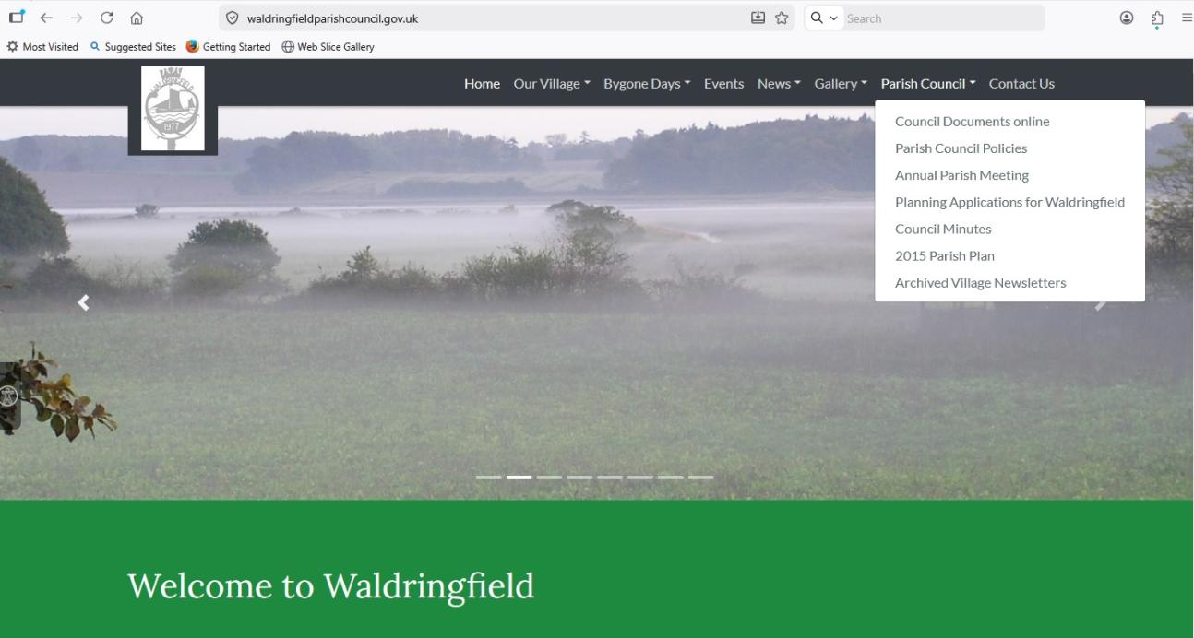
Website
Meeting dates and other information* about the Council can be found by following the ‘Parish Council’ link at the Waldringfield web site, at:
https://waldringfieldparishcouncil.gov.uk/
*Agendas, minutes, planning applications, Council policies, news, documents, village newsletter, etc.

Slide 7
Email Addresses
Following Government guidance, councillors have been allocated official email addresses, which should be used for all Parish Council business. They follow the format:
Cllr.[surname]@waldringfieldparishcouncil.gov.uk
Many thanks to the Clerk for organising the changeover.

Slide 8
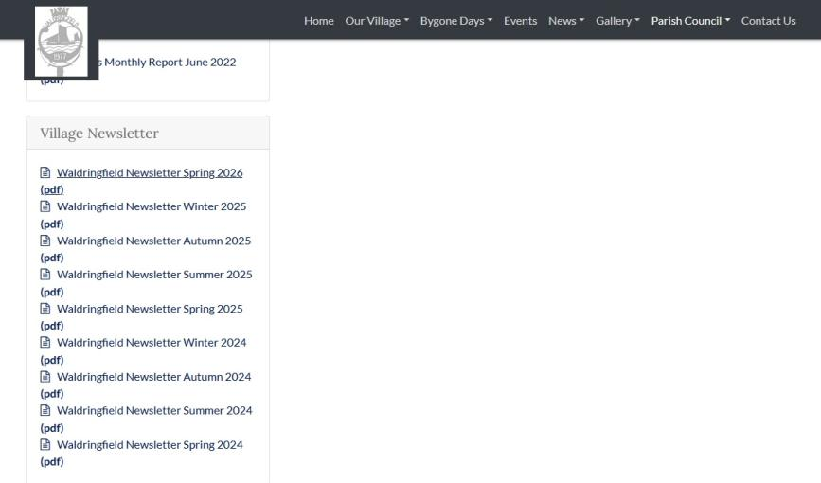
Parish Newsletter
4 Parish Newsletters are produced each year, on 1st March, 1st June, 1st September and 1st December
The Village Hall Focus has been discontinued and its content included in the PC Newsletters.
Over 250 copies are delivered, to every house in the Parish by 15 volunteers (thank you!!)
The online version can be found on the Parish Council web site:

Slide 9


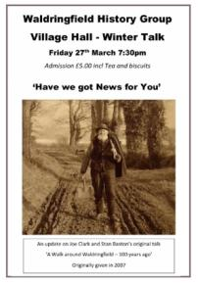
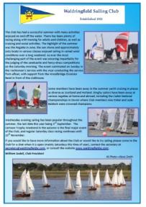
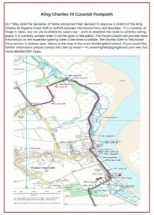
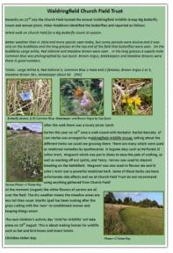

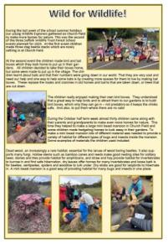
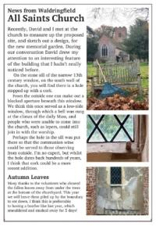
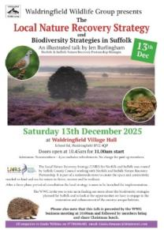
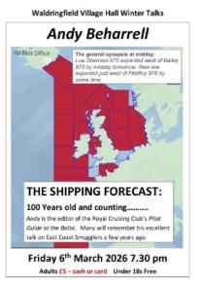
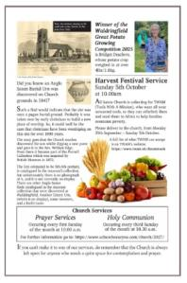
Parish Newsletter
The Clerk, Jennifer Shone-Tribley, organises its production, printing and distribution.
Local businesses can advertise in the newsletter
Non-profit making community groups may promote their activities for free
Copy deadlines are 2 weeks or so ahead of publication

Slide 10
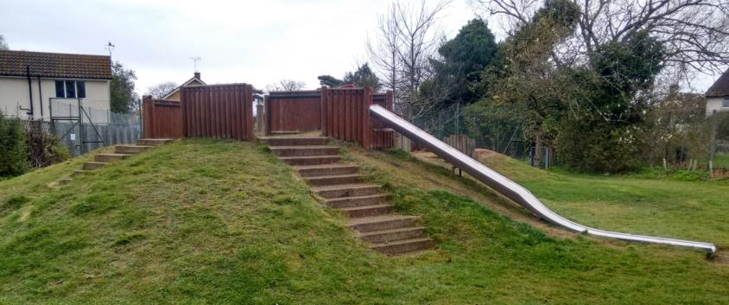
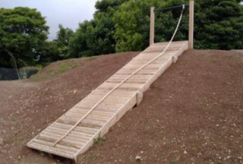
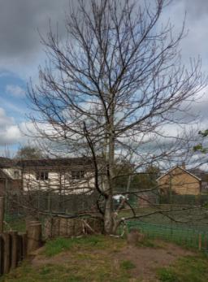
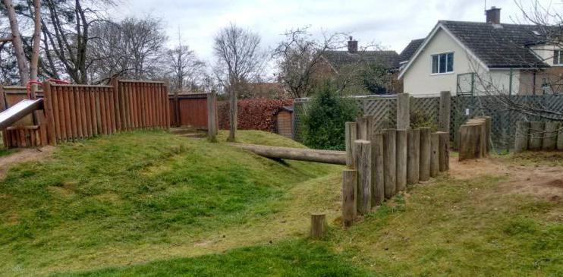
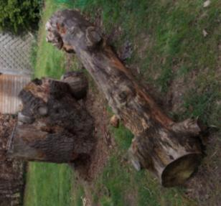
New Playing field equipment – the problem
Refurbishment of slide
Replacement of steps with a ‘scramble ramp’
Replacement of decayed ‘fort’ wood
Replacement of steps
Removal of sweet chestnut tree
New play den
Removal of decayed logs
Replacement of bridge
Removal of decayed wood

Slide 11
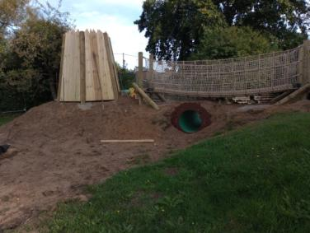
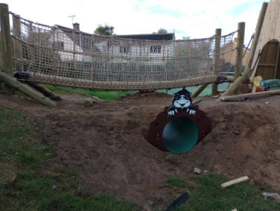
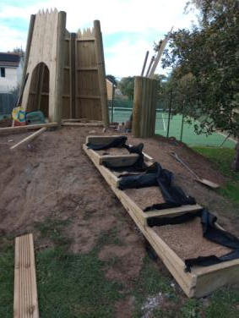
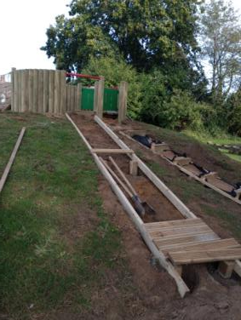
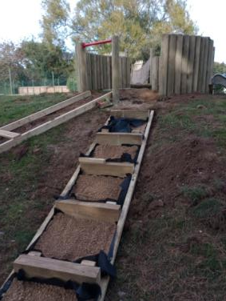
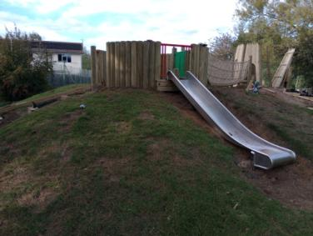
New Playing field equipment – construction work
The remains of the old equipment were dug out and removed, and the sweet chestnut tree was felled and removed. Many thanks to Sam Webber and his team for doing that!
Action Play & Leisure supplied and installed the equipment in October.

Slide 12
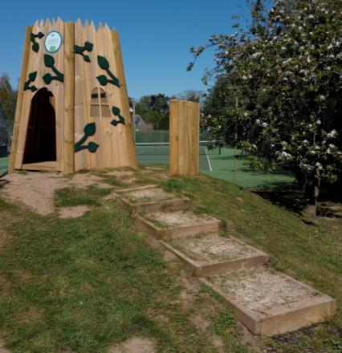
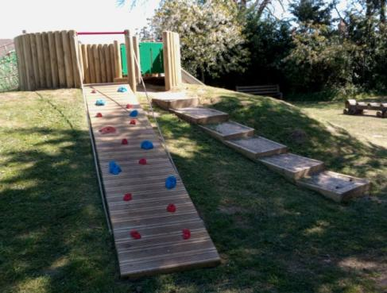
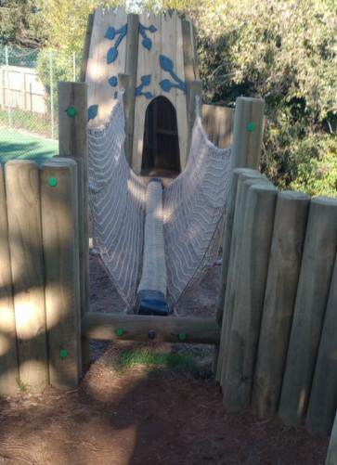
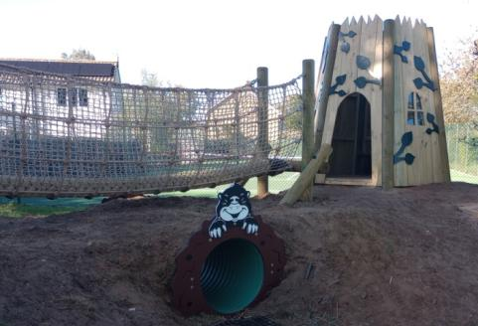
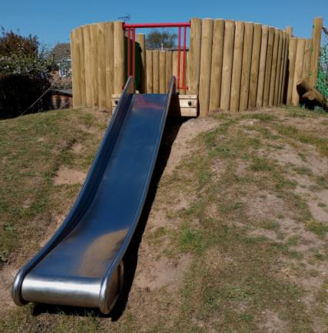
New Playing field equipment -
the finished structure

Slide 13
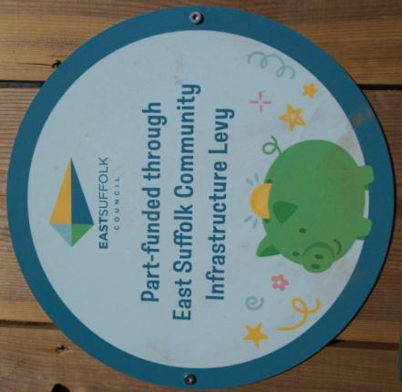
New Playing field equipment
Project Funding
SCC Locality Grant - County Councillor £3,000.00
CIL funding (2023 – 2025) £4,211.62
LCIL grant award £9,279.00
Approved allocated reserves £2,289.38
Total funding paid out £18,780.00
Project Costs
Total project costs £18,780.00

Slide 14
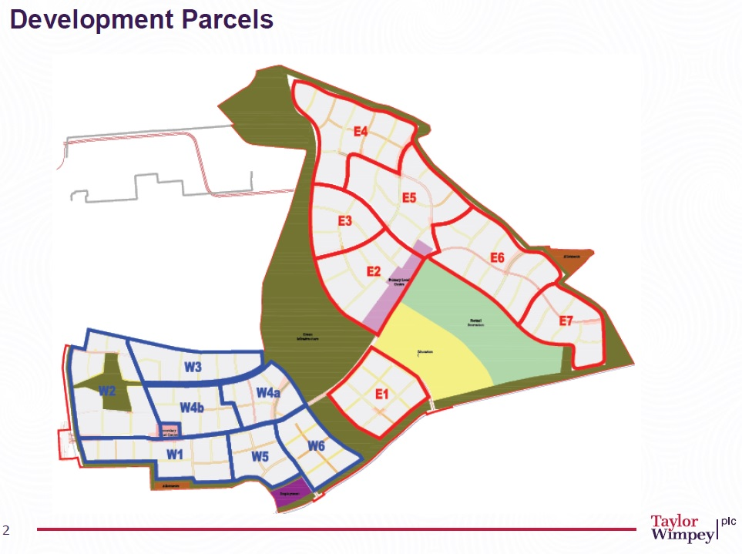
Brightwell Lakes

Slide 15
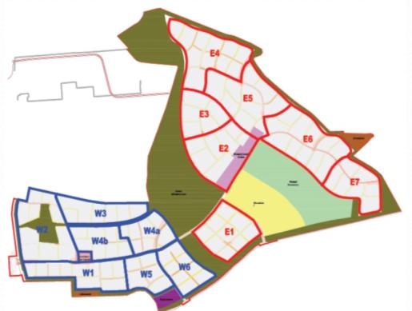
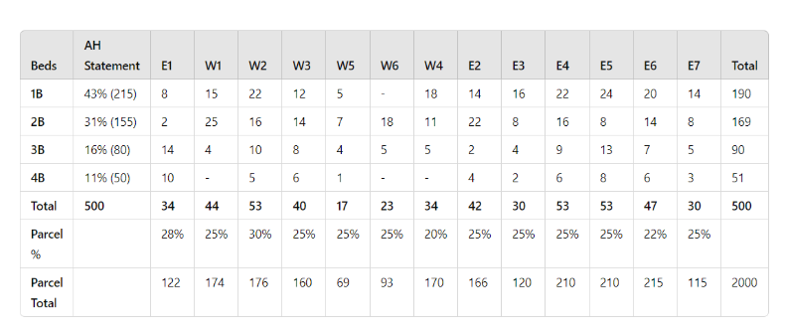
Brightwell Lakes

Slide 16
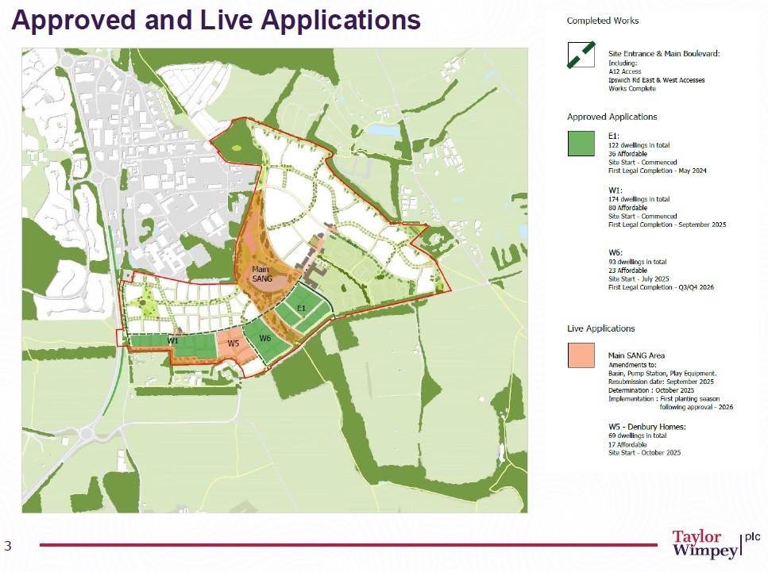
Brightwell Lakes

Slide 17
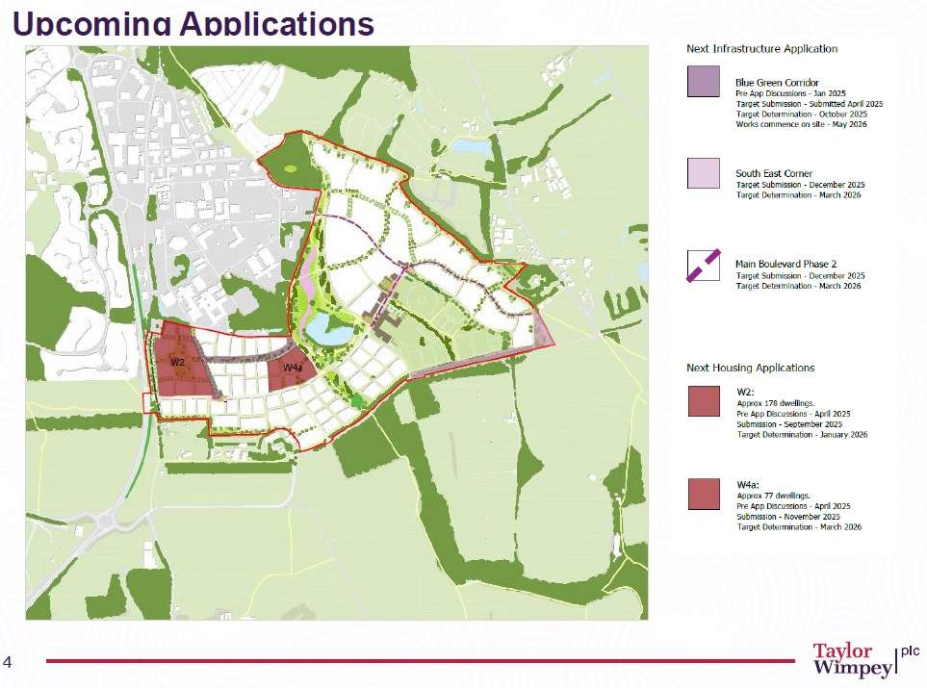
Brightwell Lakes

Slide 18
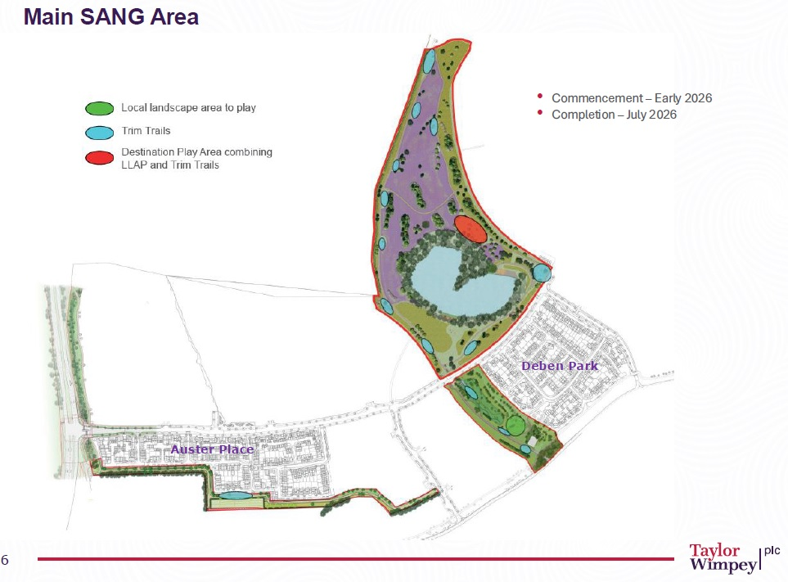
Brightwell Lakes

Slide 19
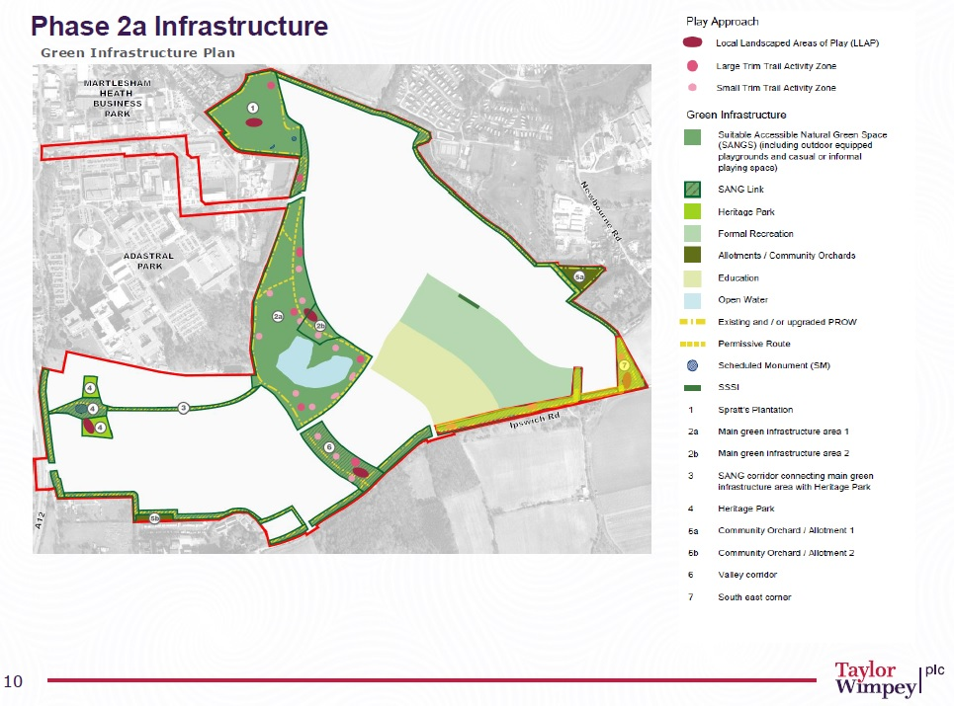
Brightwell Lakes

Slide 20
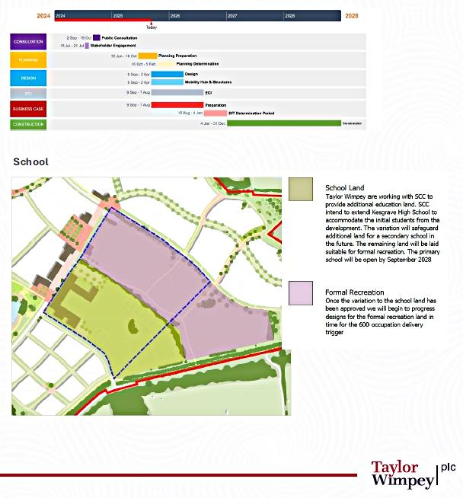
Brightwell Lakes
Upcoming Infrastructure
(School)

Slide 21
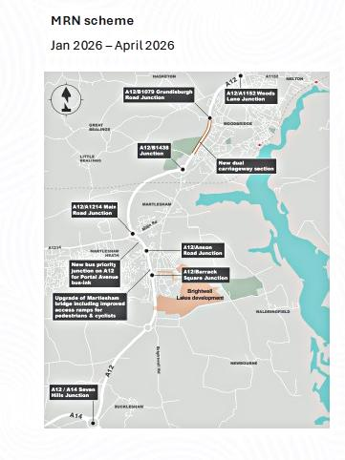
Brightwell Lakes
Upcoming Infrastructure
(A12 Improvements)
A12/B1079 Grundisburgh Road Junction
A12/A1152 Woods Lane junction
A12/B1438 junction
New dual carriageway section
A12/A1214 Main Road junction
New bus priority junction on A12 for Portal Avenue bus-link
A12/Anson Road junction
A12/Barrack Square junction
Upgrade of Martlesham bridge including improved access ramps for pedestrians & cyclists
A12/A14 Seven Hills Junction

Slide 22
Question?

